Slide 1

Data Description
Session 10
M. Kachour

Slide 2
Descriptive statistics – Bivariate
Goals :
The aim is to characterize the link (if any) between the data of two variables studied simultaneously on individuals of the same population ( or part of the population).
Remark :
The existence of the link between the data of two variables does not imply "causality" → a link that asserts that the data of one variable acts on the data of another
For example : a study showed a link between the number of rabbits in Australia and the Dow Jones index. However, it seems difficult to say that there is causality.

Slide 3
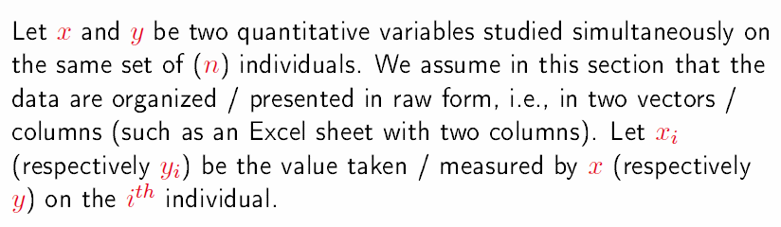
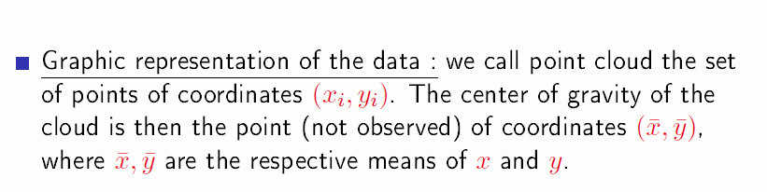
The case of two quantitatives whose data are presented in the raw state

Slide 4
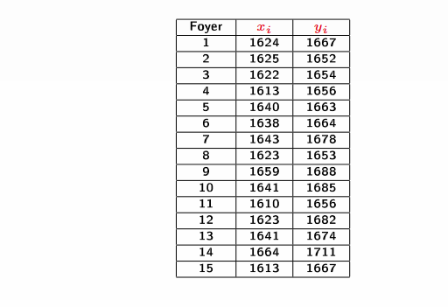


Example
Population: French households where men and women are active
Number of households studied = 15
The variables studied simultaneously on each household:
    Women's salary → $x$
    Man's salary → $y$
Goal : Evaluate the possible link between $x$ and $y$
The data :
$$\overline{x}=1631.993$$
&
$\overline{y}=1670$

Slide 5
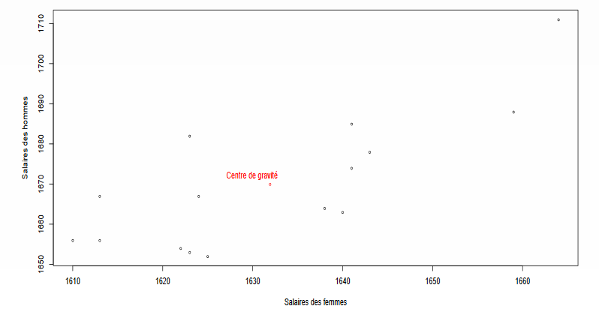
Graphical Representation – Scatter plot

Slide 6


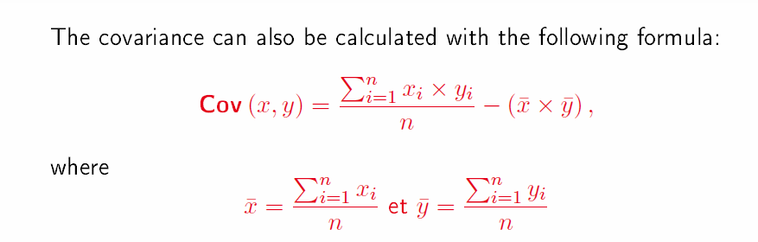
Calculation of the covariance
Covariance (the variance in common) is an indicator of the direction of variation of the two variables studied.
Covariance is noted
Formula for calculating covariance:

Slide 7
Interpretation of covariance
If the covariance is strictly positive, then it can be deduced that the data of both variables vary in the same direction (in other words, if the data of one variable increase (resp. decrease) then the data of the other will have a tendency to increase (resp. decrease) too)
If the covariance is strictly negative, then it can be deduced that the data of the two variables vary in an opposite direction (in other words, if the data of one variable increase (resp. decrease) then the data of the other will have a tendency to decrease (resp. increase))
A zero covariance does not necessarily imply the absence of a link between the data of the two variables

Slide 8
Back to example
Objective:
Calculate covariance
Comment on the result

Slide 9
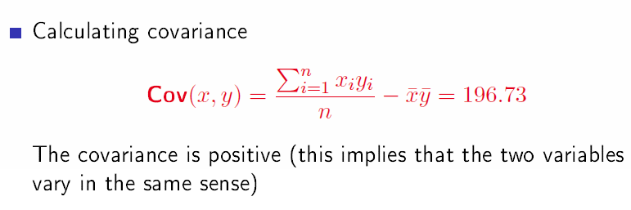
Back to example

Slide 10

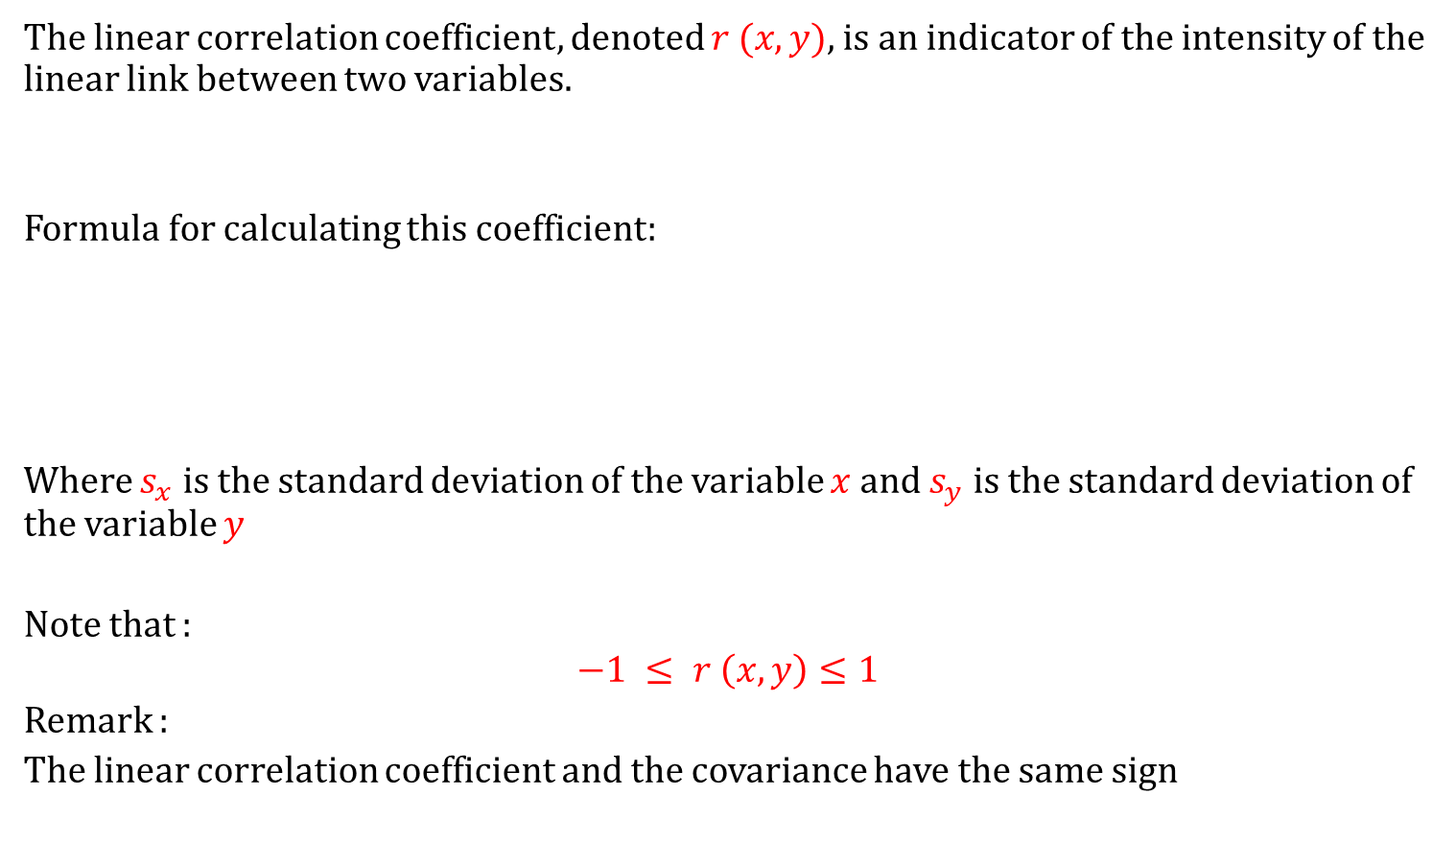
The linear correlation coefficient
The linear correlation coefficient, denoted $r (x, y)$, is an indicator of the intensity of the linear link between two variables.
Formula for calculating this coefficient:
Where $s_{x}$ is the standard deviation of the variable $x$ and $s_{y}$ is the standard deviation of the variable $y$
Note that :
$$−1 ≤ r \left(x, y\right)≤1$$
Remark :
The linear correlation coefficient and the covariance have the same sign

Slide 11
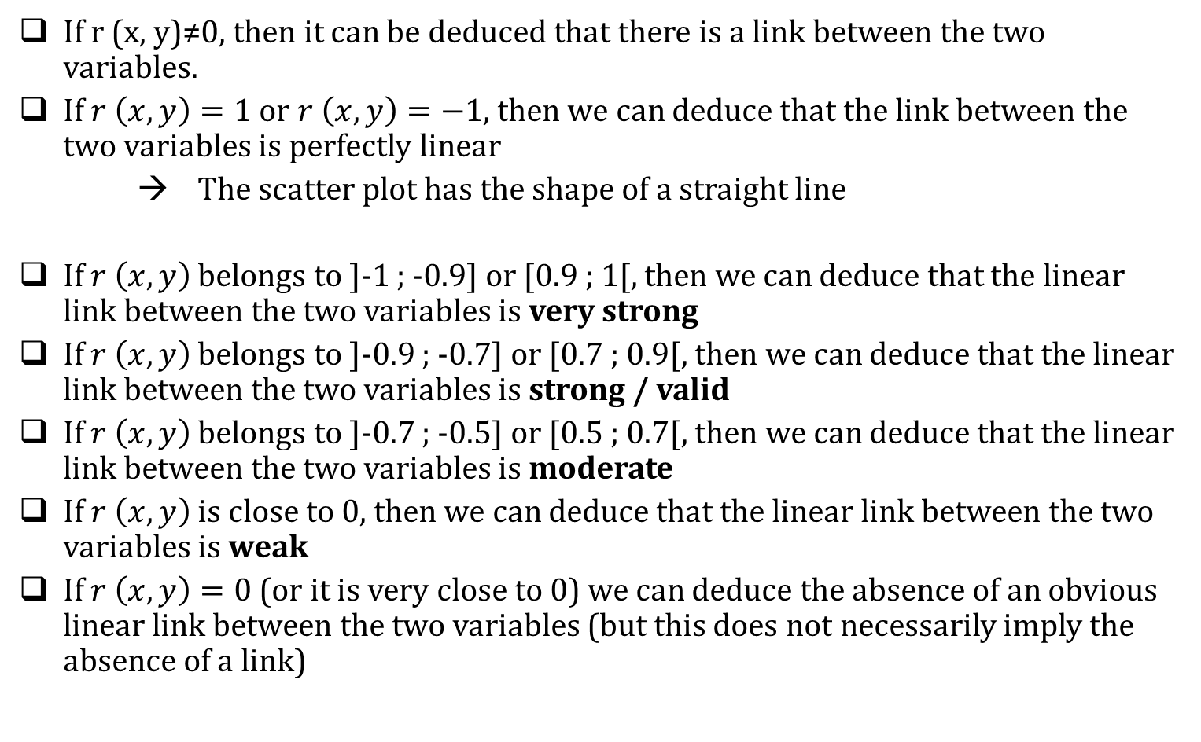
Interpretation - The linear correlation coefficient
If r (x, y)≠0, then it can be deduced that there is a link between the two variables.
If $r \left(x, y\right)=1$ or $r \left(x, y\right)=−1,$ then we can deduce that the link between the two variables is perfectly linear
→ The scatter plot has the shape of a straight line
If $r \left(x, y\right)$ belongs to ]-1 ; -0.9] or [0.9 ; 1[, then we can deduce that the linear link between the two variables is very strong
If $r \left(x, y\right)$ belongs to ]-0.9 ; -0.7] or [0.7 ; 0.9[, then we can deduce that the linear link between the two variables is strong / valid
If $r \left(x, y\right)$ belongs to ]-0.7 ; -0.5] or [0.5 ; 0.7[, then we can deduce that the linear link between the two variables is moderate
If $r \left(x, y\right)$ is close to 0, then we can deduce that the linear link between the two variables is weak
If $r \left(x, y\right)=0$ (or it is very close to 0) we can deduce the absence of an obvious linear link between the two variables (but this does not necessarily imply the absence of a link)

Slide 12
Back to example
Objective:
Calculate the linear correlation coefficient
Interpret the results

Slide 13

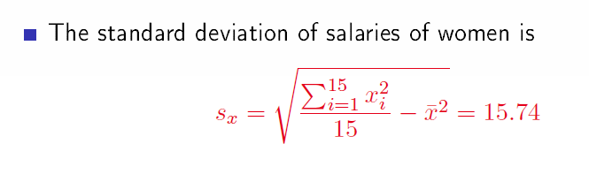

Back to example

Slide 14
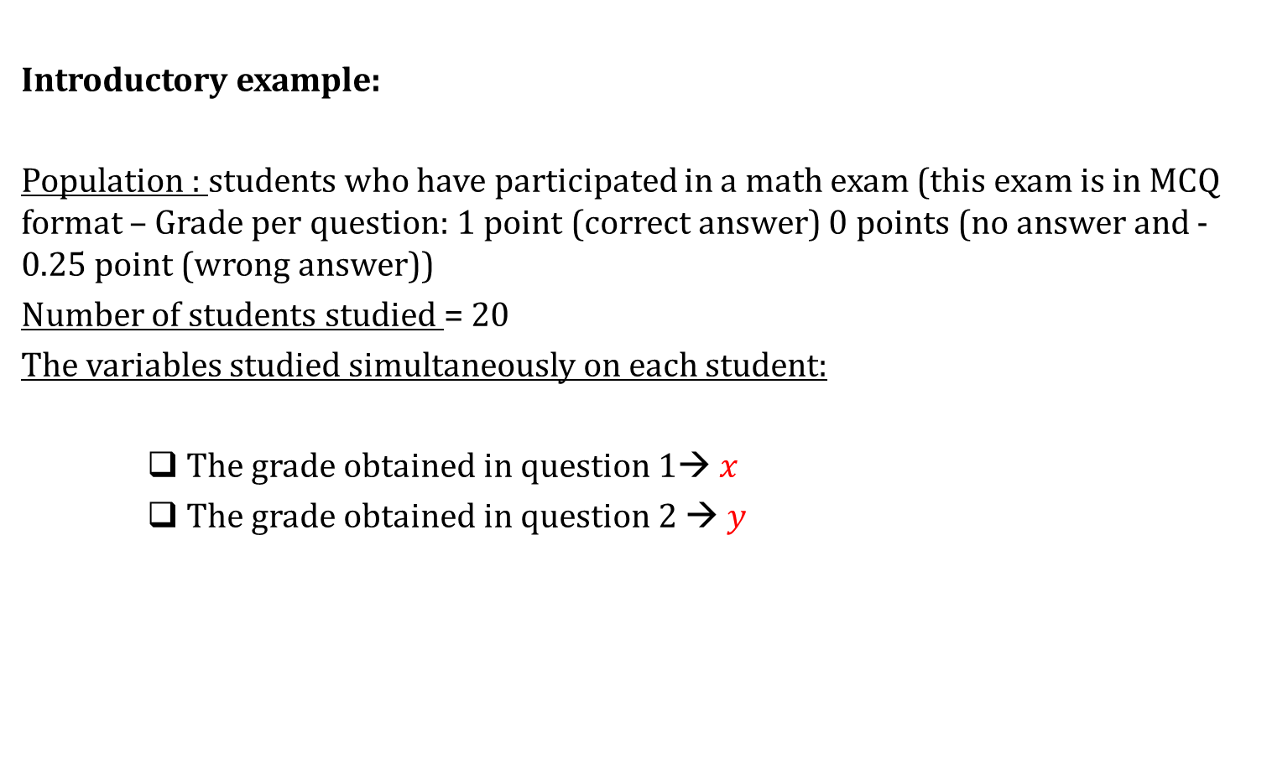
The case of two quantitatives whose data are presented in a contingency table
Introductory example:
Population : students who have participated in a math exam (this exam is in MCQ format – Grade per question: 1 point (correct answer) 0 points (no answer and -0.25 point (wrong answer))
Number of students studied = 20
The variables studied simultaneously on each student:
    The grade obtained in question 1→ $x$
    The grade obtained in question 2 → $y$

Slide 15
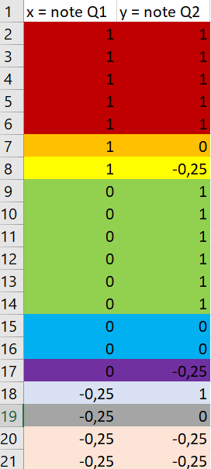
The case of two quantitatives whose data are presented in a contingency table
Introductory example:
The data
At a raw state
In a contingency table
x | y | 1 | 0 | -0.25
1 |  | 5 | 1 | 1
0 |  | 6 | 2 | 1
-0.25 |  | 1 | 1 | 2

Slide 16
The case of two quantitatives whose data are presented in a contingency table
Introductory example:
The data
x | Nb of students
1
0
-0.25
x | y | 1 | 0 | -0.25
1 |  | 5 | 1 | 1
0 |  | 6 | 2 | 1
-0.25 |  | 1 | 1 | 2
y | Nb of students
1
0
-0.25

Slide 17
The case of two quantitatives whose data are presented in a contingency table
Introductory example:
The data
x | Nb of students
1 | 7
0 | 9
-0.25 | 4
x | y | 1 | 0 | -0.25
1 |  | 5 | 1 | 1
0 |  | 6 | 2 | 1
-0.25 |  | 1 | 1 | 2
y | Nb of students
1 | 12
0 | 4
-0.25 | 4

Slide 18


The case of two quantitatives whose data are presented in a contingency table
Introductory example:
The data
x | Nb of students
1 | 7
0 | 9
-0.25 | 4
$$\overline{x}= ??$$
$${ s}_{x}= ??$$
y | Nb of students
1 | 12
0 | 4
-0.25 | 4
$$\overline{y}= ??$$
$${ s}_{y}= ??$$

Slide 19


The case of two quantitatives whose data are presented in a contingency table
Introductory example:
The data
x | Nb of students
1 | 7
0 | 9
-0.25 | 4
$$\overline{x}=0.3$$
$${ s}_{x}≈0.522$$
y | Nb of students
1 | 12
0 | 4
-0.25 | 4
$$\overline{y}=0.55$$
$${ s}_{y}≈0.557$$

Slide 20

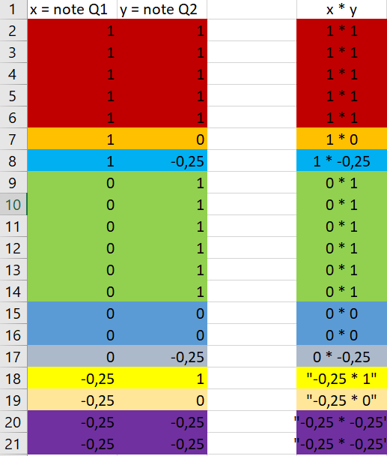

The case of two quantitatives whose data are presented in a contingency table
Introductory example:
Calculation of covariance
= ??
The covariance :
= ??

Slide 21

The case of two quantitatives whose data are presented in a contingency table
Introductory example:
Calculation of covariance
$$= \frac{1∗1 ∗5+1 ∗0 ∗1+1∗−0,25 ∗1+0∗1 ∗6+0∗0 ∗2+0 ∗−0.25 ∗1+ …+\left(−0.25\right)∗\left(−0.25\right)∗2 }{20}$$
The covariance is equal to:
$= \frac{4.625}{20} −\left(0.3 ∗0.55\right)=0.06625$

Slide 22
The case of two quantitatives whose data are presented in a contingency table
Introductory example:
Calculation and interpretition of the linear correlation coefficient
= ??

Slide 23

The case of two quantitatives whose data are presented in a contingency table
Introductory example:
Calculation of the linear correlation coefficient
The linear correlation coefficient is equal to:
$$= \frac{0.06625}{0.522 ∗0.557}=0.2278$$
The coefficient is non-zero →
This implies that there is a link between the two variables.
The coefficient belongs to [0 ; 0.5[ →
This implies that the intensity of the linear link between the two variables is weak.

